Slide 1
Types of BlockChain..
By: Harsh Gupta

Slide 2
What is BlockChain..
Blockchain technology enables distributed public ledgers that hold immutable data in a secure and encrypted way and ensure that transactions can never be altered. While Bitcoin and other cryptocurrencies are the most popular examples of blockchain usage.
This “distributed ledger technology” (DLT) is finding a broad range of uses. Data storage, financial transactions, real estate, asset management and many more uses are being explored.
Each block contains a cryptographic hash of the previous lock, a timespan, and transaction data (generally represented as a Merkle tree.

Slide 3
Types of BlockChain!
1. Public Blockchain

Slide 4
Types of BlockChain!
1. Public Blockchain
2. Private Blockchain

Slide 5
Types of BlockChain!
1. Public Blockchain
2. Private Blockchain
3. Consortium or Federated Blockchain

Slide 6
Public BlockChain..
A public blockchain as its name suggests is the blockchain of the public, meaning a kind of blockchain which is-
‘ for the people, by the people and of the people’

Slide 7
Private BlockChain..
Private blockchain as its name suggests is a private property of an individual or an organization.
Unlike public blockchain here there is an in charge who looks after of important things such as read/write or whom to selectively give access to read or vice versa.

Slide 8
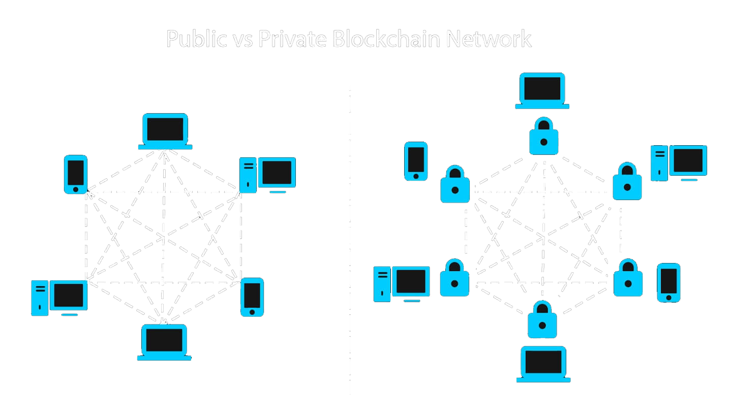

Slide 9


Slide 10
Consortium BlockChain..
This type of blockchain tries to remove the sole autonomy which gets vested in just one entity by using private blockchains.
So here you have more than one incharge. Basically, you have a group of companies or representative individuals coming together and making decisions for the best benefit of the whole network. Such groups are also called consortiums or a federation that’s why this is named consortium or federated blockchain.

Slide 11
After understanding all three different types I had a question that why do we need all of them?

Slide 12
We require more types of blockchain because keeping such blockchains solves problems such as:-

Slide 13
We require more types of blockchain because keeping such blockchains solves problems such as:-
One no longer need to rely upon huge servers.

Slide 14
We require more types of blockchain because keeping such blockchains solves problems such as:-
- One no longer need to rely upon huge servers.
They are cost effective and fast.

Slide 15
We require more types of blockchain because keeping such blockchains solves problems such as:-
- One no longer need to rely upon huge servers.
- They are cost effective and fast.
They reduce the need for more trusted parties because you can implement smart contracts instead of them.

Slide 16
We require more types of blockchain because keeping such blockchains solves problems such as:-
- One no longer need to rely upon huge servers.
- They are cost effective and fast.
- They reduce the need for more trusted parties because you can implement smart contracts instead of them.
Gives options for rights and access management while leveraging the same blockchain technology and reaping its benefits.

Slide 17
We require more types of blockchain because keeping such blockchains solves problems such as:-
- One no longer need to rely upon huge servers.
- They are cost effective and fast.
- They reduce the need for more trusted parties because you can implement smart contracts instead of them.
- Gives options for rights and access management while leveraging the same blockchain technology and reaping its benefits.
Reduces redundant work.

Slide 18
We require more types of blockchain because keeping such blockchains solves problems such as:-
- One no longer need to rely upon huge servers.
- They are cost effective and fast.
- They reduce the need for more trusted parties because you can implement smart contracts instead of them.
- Gives options for rights and access management while leveraging the same blockchain technology and reaping its benefits.
- Reduces redundant work.
- Distributed consensus between interested parties becomes fast even though you are geographically segregated.

Slide 19
Because of all these, I think different types of blockchain will be used for different type of industries when required.
Where we require privacy and control, private & consortium blockchain will be a good option and where we require openness, as well as censorship resistance public blockchains, are a must need.
And that’s why different people are discussing different use cases of the blockchain tech across various industry verticals.

Slide 20
Thank You..

